Slide 1

Housing Prices Correlated Factors and Statistical Analysis
By: Tedman Zhuang

Slide 2
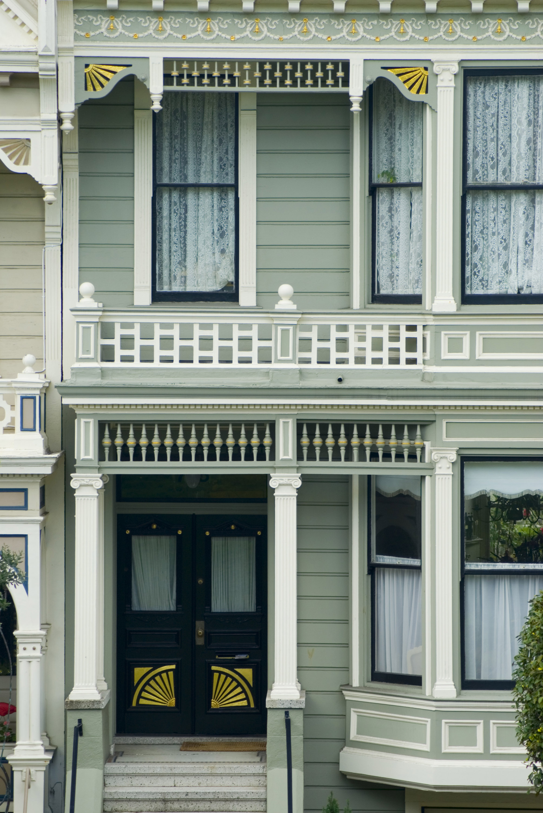
Project Goal
What factors are heavily correlated with housing prices?
Does having a basement and/or multiple stories affect sale price?
What factors negatively correlate to sale price and by how much?
This Photo by Unknown Author is licensed under CC BY

Slide 3
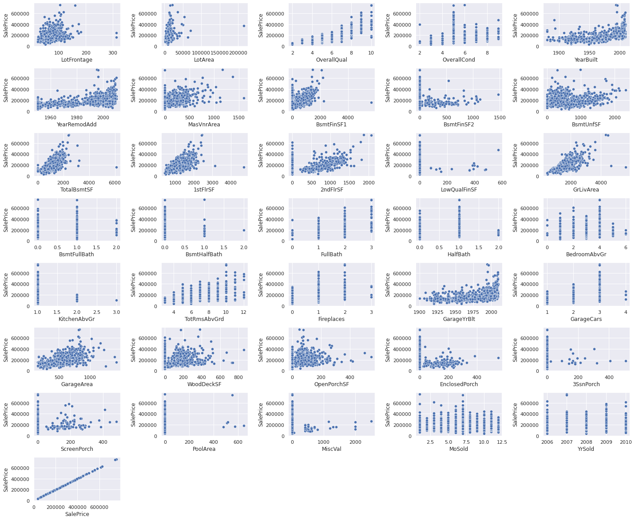
Highly Correlated Factors
By calculating the correlation coefficients between sale price and the other numerical factors in the data, I found that the following factors are highly positively correlated with sale price: overall quality, year built, year remodeled, square footage, number of bathrooms, number of rooms, and the amount cars that fit in the garage. We can also visualize this through a scatter plot analysis.

Slide 4
Hypotheses
Null Hypothesis 1 (H₀):
Having a basement does not have an effect on sale price
Alternate Hypothesis 1 (H_{a}):
Having a basement does have an effect on sale price
------------------------------------------------
Null Hypothesis 2 (H₀):
Having a 2nd floor does not have an effect on sale price
Alternate Hypothesis 2 (H_{a}):
Having a 2nd floor does have an effect on sale price
Null Hypothesis 3 (H₀):
Having an enclosed porch does not have an effect on sale price
Alternate Hypothesis 3 (H_{a}):
Having an enclosed porch does have an effect on sale price

Slide 5
Analysis of Basement
Reject the null hypothesis that there is no difference in sale price of homes with a basement. There is a statistically significant difference in sale price. The 95% confidence interval of the difference in sale price mean is [-$87,771.92, -$66,678.85]. This means that having a basement should indicate a higher price.

Slide 6
Analysis of 2nd Floor
Reject the null hypothesis that there is no difference in sale price of homes with a 2nd floor. There is a statistically significant difference in sale price. The 95% confidence interval of sale price mean is [-$30,375.98, -$13,759.64]. This means that having a 2nd floor should indicate a higher price.

Slide 7
Analysis of Enclosed porch
Reject the null hypothesis that there is no difference in sale price of homes with an enclosed porch. There is a statistically significant difference in sale price. The 95% confidence interval of sale price mean is [$32,185.51, -$51143.38]. This means that having an enclosed porch should indicate a lower sale price

Slide 8
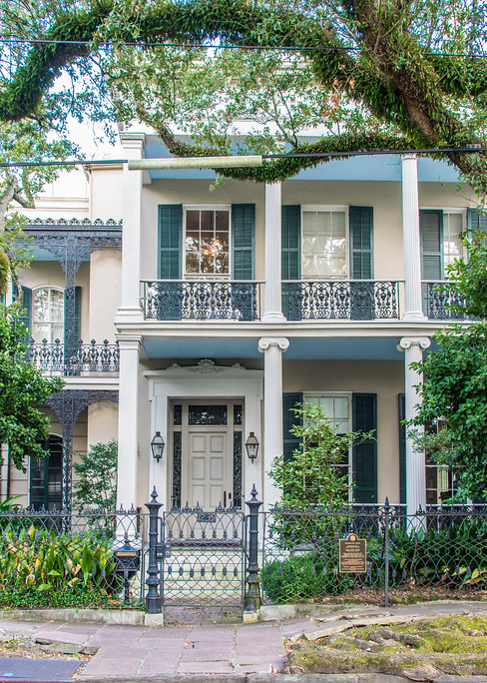
Statistical Analysis Conclusions and Recommendations
The statistical analysis showed that having a basement and 2nd floor significantly increases the sale price of a home.
The analysis also showed that having an enclosed porch significantly decreased the sale price of a home.
I would recommend investing in homes with 2nd floors and basements, while staying away from homes with enclosed porches.
This Photo by Unknown Author is licensed under CC BY-NC

